Slide 1
Hyperledger Composer
- Kaustubh Oak & Deepak Parmar
Getting Started…
Notes:
This presentation assumes that the audience has seen Blockchain Explained (https://ibm.box.com/v/BlockchainExplained)

Slide 2
Contents
What Composer is?
Why Composer?
Composer Components & Architecture
How to use Composer?
Demo – Composer + Fabric 1.0

Slide 3
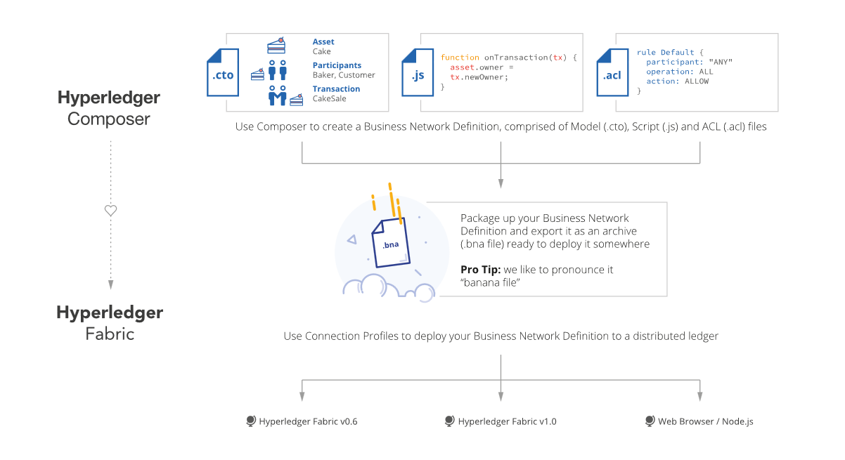
What Hyperledger Composer is?
“ Hyperledger Composer is a framework to accelerate the development of applications built on top of Blockchain platforms “
A business network definition is the collection of user developed source artefacts that describe the resources and logic in a business network:
Model files describe assets, participants, and transactions.
Access control lists define rules for sharing and privacy.
Transaction implement additional business requirements.
Can be packaged into a business network archive, or a banana (.bna) file.

Slide 4
Why Hyperledger Composer?
Accelerate development
Business-centric vocabulary
Decoupled business network
Rules for privacy across the business network
Wallet and Identities management etc…

Slide 5
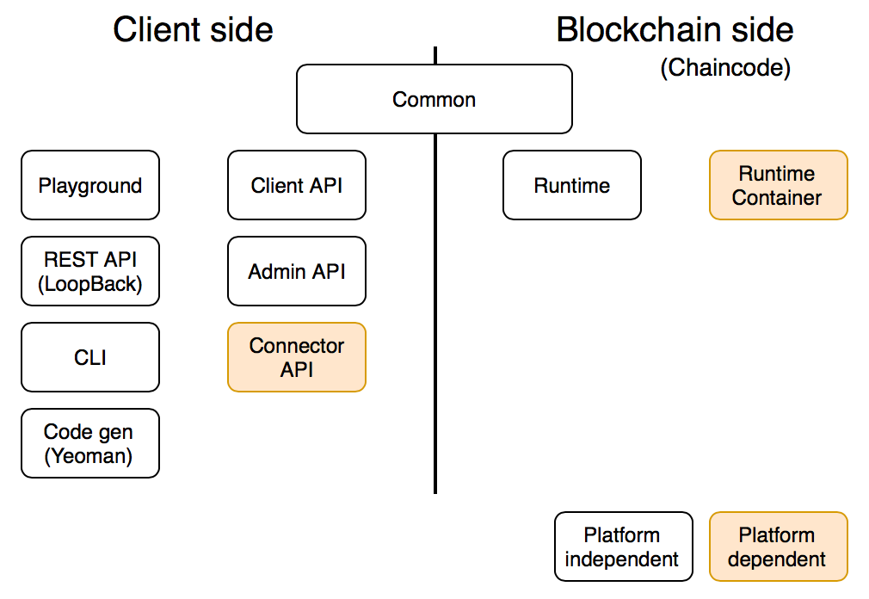
Composer Components

Slide 6
Client side components
The majority of the components are client side components, and provide functionality for developing solutions with Hyperledger Composer:
Playground for developing and testing business networks from a browser.
Client/Admin APIs
Command line interface
REST API generation using LoopBack (http://loopback.io)
Code generation using Yeoman (http://yeoman.io)
Editor plugins for Atom (http://atom.io) and VS Code (https://code.visualstudio.com)
These components make calls to the Blockchain platform in order to interact with the deployed business network (by calling the generic chaincode/smart contract).

Slide 7
Blockchain side components
The rest of the components are Blockchain side components, and provide functionality for running a deployed business network:
Persistence of resources (assets, participants, transactions) into registries, which are backed by the underlying world state provided by the Blockchain platform.
Access control enforcement by using the identity (certificate) of the participant who submitted the request.
Execution of user developed transaction processor functions, and the publishing and recording of any business events.
These components expose a set of APIs that can be called by client components to interact with the deployed business network (by calling the generic chaincode/smart contract).

Slide 8
Composer Architecture
Client
App
Blockchain Platform (fabric)
Composer
Deploy / Update / Undeploy
composer-admin
gRPC call
composer-client
composer-rest-server
(Lookback Connector)
REST call

Slide 9
How to use Hyperledger Composer?

Slide 10
Development Environment Setup
Windows: Dev Box Location: https://github.com/dparmar1/composerdevbox
( Clone git repository and follow README.md file )
Linux & Mac: Follow Link: https://hyperledger.github.io/composer/installing/development-tools.html

Slide 11
Development Work-Flow
1 Write Business Network
Output: ‘bna’ file (Business Network Archive)
2 Deploy Business Network
Output: gRPC or REST API
3 Consume Business Network

Slide 12
Write Business Network
1. Using Composer Playground
Online : https://composer-playground.mybluemix.net/editor
Locally: https://hyperledger.github.io/composer/installing/using-playground-locally.html
Playground Tutorial: https://hyperledger.github.io/composer/tutorials/playground-guide.html
2. Using Editors
VS Code Editor (https://code.visualstudio.com)
Atom Editor (http://atom.io)
Developer Guide :
https://hyperledger.github.io/composer/business-network/business-network-index.html
https://hyperledger.github.io/composer/tutorials/developer-guide.html

Slide 13
Deploy Business Network
Download fabric tools and Create Connection Profile
Follow Step 2 : https://hyperledger.github.io/composer/installing/development-tools.html
Connection Profile : https://hyperledger.github.io/composer/reference/connectionprofile.html
2. Use ‘composer-cli’ module to deploy/undeploy/update smart contracts
“composer network” Command
https://hyperledger.github.io/composer/business-network/bnd-deploy.html
https://hyperledger.github.io/composer/reference/composer.network.deploy.html
Example:
composer network deploy -a <business-network-archive> -i <enrollment-id> -s <enrollment-secret> -p <connection-profile>

Slide 14
Consume Business Network
1. Using composer playground
2. Using ‘composer-client’ and ‘composer-admin’ javascript module
Getting Started : https://hyperledger.github.io/composer/applications/node.html
3. Using ‘composer-rest-server’ javascript module Getting started : https://hyperledger.github.io/composer/integrating/getting-started-rest-api.html
Configuration : https://hyperledger.github.io/composer/integrating/deploying-the-rest-server.html
Authentication: https://hyperledger.github.io/composer/integrating/enabling-rest-authentication.html
4. Using Yoman composer generator
- CLI app: use ‘composer-client’ and ‘composer-admin’
- Angular 2 app : use ‘composer-rest-server’ REST API

Slide 15
Limitation with Composer
- Can’t deploy smart contract on fabric 0.6 service of Bluemix or Cloud , consistently ( never going to fix in fabric 0.6, already fixed in fabric 1.0-beta but not tested as couldn’t get bluemix fabric 1.0 service)
- Only CRUD REST API supported, can’t use custom query ( will be supported in composer 1.0) - Only default endorsement policy, can’t apply endorsement policy while deploying business network (will be supported in composer 1.0)

Slide 16
Miscellaneous
npm Modules
Modeling Language
Access Control Language
Connection Profile
Transaction Processor Functions
Command Line Interface
CLI Add Participant
CLI Issue Identity
CLI Revoke Identity
CLI Import Identity
Diagnosing Problems

Slide 17
References
Tutorials: https://hyperledger.github.io/composer/tutorials/tutorials.html
API Docs: https://hyperledger.github.io/composer/jsdoc/index.html
Help & Queries:
RocketChat - https://chat.hyperledger.org/channel/composer StackOverflow - https://stackoverflow.com/questions/tagged/hyperledger-composer

Slide 18
Demo and Q&A

Slide 19
Thank you!

